Slide 1
PRESENTATION ON QUEUE
SUBMITTED BY: Samrat neupane ROllno : ace077bct074

Slide 2
What is Queue ?
Queue can be described as a Collection of Elements that is based on First In First Out (FIFO) principle, which means the first element that is added to the queue is the first element that is processed or removed from the queue.

Slide 3
Importance Of Queue
Queues are widely used in operating systems, computer networks, and various software applications to manage tasks, process requests, and handle data streams. They can also be used in real-world scenarios such as waiting lines at a store, where the first person who joins the queue is the first person who is served.

Slide 4
Types Of Queue
Linear Queue: A linear queue is a basic queue in which elements are stored in a linear or sequential manner. This means that new elements are added at the back of the queue, and elements are removed from the front of the queue. In other words, a linear queue follows the "First In, First Out" (FIFO) principle.
INSERT
1 | 2 | 3 | 4
DELETE
front
Rear

Slide 5
Circular Queue
Circular Queue: A circular queue is similar to a linear queue, but instead of using a fixed-sized array, it uses a circular buffer to store elements. This means that when the last element of the queue is reached, the next element is stored at the beginning of the buffer. This creates a circular pattern, allowing the queue to reuse space and function more efficiently.
Front
Rear

Slide 6
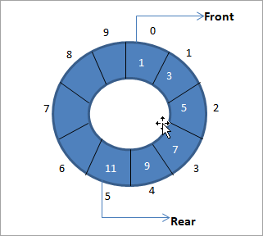
​1 | ​3 | ​5 | ​7 | ​9 | ​11

Slide 7
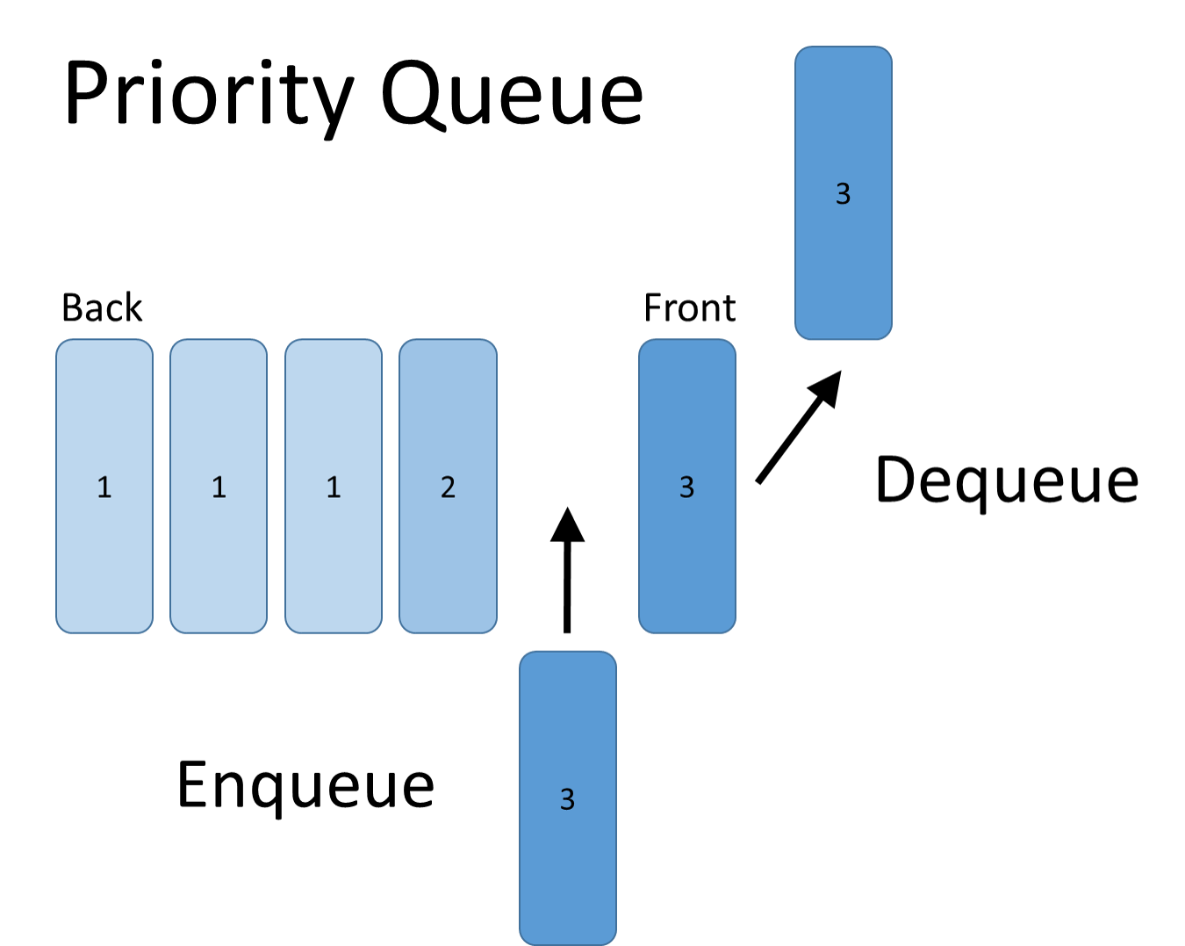
Priority Queue
A priority queue is a special type of queue where each element has a priority value assigned to it. Elements with higher priority are given higher preference and are dequeued first.
This means that a priority queue does not always follow the "First In, First Out" (FIFO) principle, but rather the "Highest Priority First" principle.

Slide 8
Double Ended Queue
the deque stands for double ended queue. deque is a linear data structure where the insertion and deletion operations are performed from both ends. we can say that deque is a generalized version of the queue. though the insertion and deletion in a deque can be performed on both ends, it does not follow the fifo rule.
Insertion, Deletion
1 | 2 | 3 | 4
Insertion , DELETE
front
Rear

Slide 9
Implementation of Queue
Array-Based Implementation: An array-based implementation of a queue involves using a fixed-size array to store the elements. In this implementation, a variable is used to keep track of the front and rear of the queue. Elements are added to the rear of the queue and removed from the front of the queue. If the queue becomes full, it is not possible to add any more elements. This implementation is efficient in terms of time complexity for accessing elements but can become inefficient if the array needs to be resized.
Linked List-Based Implementation: A linked list-based implementation of a queue involves using a linked list data structure to store the elements. In this implementation, a variable is used to keep track of the front and rear of the queue. Elements are added to the rear of the queue and removed from the front of the queue. This implementation is efficient in terms of space complexity as the linked list can grow or shrink dynamically, but it may not be as efficient in terms of time complexity as accessing elements requires traversing the linked list.

Slide 10
Queue Operations
Enqueue: This operation adds an element to the rear of the queue. In other words, it inserts a new element into the queue.
Dequeue: This operation removes the element from the front of the queue. In other words, it removes the oldest element from the queue.
Peek: This operation returns the element at the front of the queue without removing it. In other words, it retrieves the oldest element in the queue.
IsEmpty: This operation checks whether the queue is empty. If the queue is empty, it returns true, otherwise, it returns false.

Slide 11
In case of The Priority Queue , the dequeue operations may not always remove the first element but remove the element the element with the highest priority.
In case of the double ended queue, there are additional operations such as "Insert Front", "Remove Front", "Insert Rear", and "Remove Rear" that allow elements to be added or removed from either end of the deque.

Slide 12
Algorithm
Enqueue()
Dequeue()
Start
Initialize front =0 and rear =1
If rear > =MAXSIZE-1;
Print "Queue Overflow"
Else
Set , rear=rear+1;
Queue[rear]=item
Stop
Start
If rear <front;
Print "Queue is empty"
Else
Item= queue[front++];
Print "item deleted"
Stop

Slide 13
Algorithm for Circular Queue
Enqueue()
Dequeue()
Start
Check the queue full condition as
if(front == (rear +1)% MAXSIZE) printf queue is full and exit else rear= (rear+1)%MAXSIZE
cqueue[rear]=item
Stop
Start Check the queue as empty condition if(rear == front) Print("Queue is empty) else front==(front+1)% Maxsize
Item = cqueue[front];
Return item
Stop

Slide 14







